Slide 1
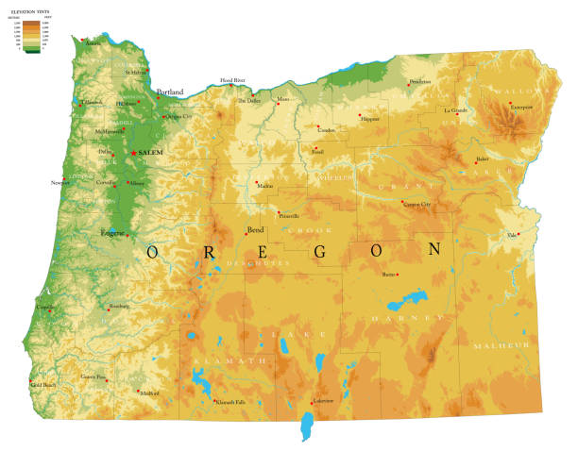
COMBATING ADOLESCENT SUBSTANCE ABUSE IN OREGON
A Community-Centric Approach
By
Navin Kumar Balagopal

Slide 2


BRIEF DESCRIPTION OF INTERVENTION
● What is the issue you are hoping to address?
● What would success look like?
● Who is the target audience of this intervention?
● Who are the people or organizations in charge of implementing this intervention?

Slide 3
INTERVENTIONS & THEORY OF CHANGE
Issue Addressed:
The primary issue aimed at addressing through this intervention is the high rate of substance abuse among adolescents in Oregon, which mirrors a broader national trend. Substance abuse in this age group can lead to a multitude of problems including poor academic performance, mental health issues, and a potential lifetime of addiction.
Vision of Success:
Success would manifest as a significant reduction in the rates of substance abuse among adolescents within the community. This would be measured through a decrease in the percentage of teens reporting drug and alcohol use, improved academic performances, better mental health statistics, and a reduced rate of substance-related incidents within the community.
Target Audience:
The core target audience for this intervention is adolescents aged 12 to 20 residing in Oregon, with a particular focus on those in lower socioeconomic statuses as they often have less access to preventative resources and treatment.
Implementing Bodies:
The intervention will be spearheaded by a coalition comprising the Oregon Health Authority, local schools, community organizations specializing in substance abuse prevention, and local healthcare providers. Engaging a diverse group of stakeholders will ensure a holistic approach to addressing adolescent substance abuse in Oregon, while also fostering community buy-in and sustainability.

Slide 4
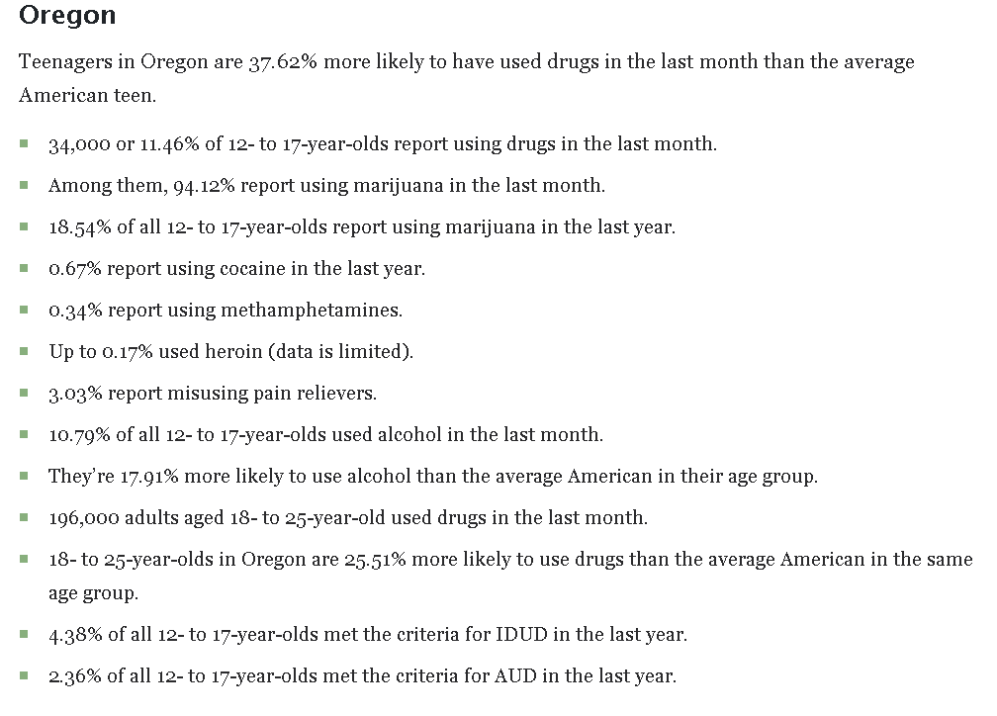
ISSUE ADDRESSED:
The intervention primarily targets the escalating rates of substance abuse among adolescents in Oregon.
This problem is reflective of a larger national issue, indicating a need for urgent action.
1. Deterioration in academic performance
Consequences of substance abuse in adolescents:
2. Emergence or exacerbation of mental health issues
3. Potential onset of lifelong addiction issues

Slide 5
VISION OF SUCCESS
A substantial reduction in adolescent substance abuse rates within the community.
Measurable Outcomes:
Decrease in the percentage of adolescents reporting drug and alcohol use.
Improvement in academic performance indicators among the target age group.
Better mental health statistics among adolescents.
Reduction in substance-related incidents reported within the community, like DUIs, substance-related accidents, etc.

Slide 6
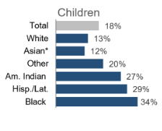
TARGET AUDIENCE:
Adolescents aged 12 to 18 residing in Oregon.
Poverty Rate Among Children
by race in Oregon in 2019
Special emphasis on those belonging to lower socioeconomic statuses due to:
Limited access to preventative resources
Reduced availability of treatment facilities

Slide 7
IMPLEMENTING BODIES:
Holistic approach: Diverse stakeholders bring varied expertise ensuring a comprehensive approach to tackling adolescent substance abuse.
Community Buy-in: Involvement of local bodies fosters community acceptance and engagement.
Sustainability: Engaging multiple stakeholders including local authorities ensures a sustained effort towards combating substance abuse, beyond the duration of the project.

Slide 8
SO THAT DIAGRAM
Start |  |  |  | End Here (Goal):
Implement comprehensive substance abuse prevention and education programs in schools and communities in Oregon. | Adolescents and their families are well-informed about the risks and consequences of substance abuse. | There's a change in attitude towards substance use and an increased utilization of available substance abuse prevention and treatment resources | Adolescents engage in healthier behaviors, reducing the rates of substance abuse. | The community sees improved adolescent mental and physical health, better academic performance, and a safer, more supportive environment for its youth.
So that… | So that… | So that… | So that…

Slide 9
BRIEF DESCRIPTION OF INTERVENTION
● What is the issue you are hoping to address?
● What would success look like?
● Who is the target audience of this intervention?
● Who are the people or organizations in charge of implementing this intervention?

Slide 10
BRIEF DESCRIPTION OF INTERVENTION
● What is the issue you are hoping to address?
Issue Addressed: The primary issue aimed at addressing through this intervention is the high rate of substance abuse among adolescents in Oregon, which mirrors a broader national trend. Substance abuse in this age group can lead to a multitude of problems including poor academic performance, mental health issues, and a potential lifetime of addiction.
● What would success look like?
● Who is the target audience of this intervention?
● Who are the people or organizations in charge of implementing this intervention?

Slide 11
BRIEF DESCRIPTION OF INTERVENTION
● What is the issue you are hoping to address?
● What would success look like?
Vision of Success: Success would manifest as a significant reduction in the rates of substance abuse among adolescents within the community. This would be measured through a decrease in the percentage of teens reporting drug and alcohol use, improved academic performances, better mental health statistics, and a reduced rate of substance-related incidents within the community.
● Who is the target audience of this intervention?
● Who are the people or organizations in charge of implementing this intervention?

Slide 12
BRIEF DESCRIPTION OF INTERVENTION
● What is the issue you are hoping to address?
● What would success look like?
● Who is the target audience of this intervention?
Target Audience: The core target audience for this intervention is adolescents aged 12 to 20 residing in Oregon, with a particular focus on those in lower socioeconomic statuses as they often have less access to preventative resources and treatment.
● Who are the people or organizations in charge of implementing this intervention?

Slide 13
BRIEF DESCRIPTION OF INTERVENTION
● What is the issue you are hoping to address?
● What would success look like?
● Who is the target audience of this intervention?
● Who are the people or organizations in charge of implementing this intervention?
Implementing Bodies: The intervention will be spearheaded by a coalition comprising the Oregon Health Authority, local schools, community organizations specializing in substance abuse prevention, and local healthcare providers. Engaging a diverse group of stakeholders will ensure a holistic approach to addressing adolescent substance abuse in Oregon, while also fostering community buy-in and sustainability.

Slide 14


LOGIC MODEL DIAGRAM
Inputs | Activities | Outputs | Outcomes | Impact
Funding from various sources | Establishing referral processes | Adolescents receiving short-term therapy | Better access to substance abuse prevention and treatment resources | Improved mental and physical health
Trained personnel | Conducting substance abuse education and prevention programs | Families receiving assistance | Improved academic performance | Reduced rates of substance abuse
Local support | Providing short-term therapy and counselling services | Enhanced coordination between local entities | Enhanced community safety | Enhanced community support systems
Substance abuse prevention and treatment resources | Coordinating care and support services | Increased awareness and understanding of substance abuse risks | Improved social relationships among adolescents | A safer and more supportive community environment

Slide 15
DATA INDICATORS
 | Data Indicators | Items
Input | Amount of funding secured for the program #of Therapists on staff # of community partnerships | Funding Amount Number of therapists Number of partnerships formed
Activities | # of education sessions conducted # of therapy sessions provided # of referrals made to local mental health providers | Substance abuse education sessions Short-term therapy provision Referral process establishment
Outputs | # of adolescents reached # of clients who received short-term therapy # of families assisted | Adolescents receiving education Adolescents receiving short-term therapy Families receiving assistance
Outcomes | % of families accessing long-term services % of families reporting improved access to care % of families satisfied with services received | Long-term services utilization Improved access to care Satisfaction with services

Slide 16
MEASURING POPULATION LEVEL DATA
1. Select a data source to help your measure the population level impact of your intervention
2. Select the specific indicator you will use to evaluate impact (i.e. % of adults reporting good
mental health, % of adolescents who report positive relationships)
3. Answer the following reflection questions:
● How difficult or easy was it to find data that was appropriate for your indicator?
● What are some of the limitations of this data? (is it only available for certain people, at
certain frequencies?)
● In an ideal world, what would your ideal data indicator be?
● Explain why this particular indicator would be critical evidence to advancing public health
knowledge of this area

Slide 17
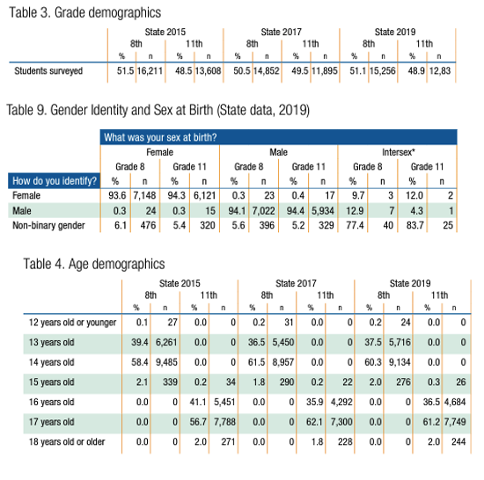
SELECT A DATA SOURCE TO HELP YOUR MEASURE THE POPULATION LEVEL IMPACT OF YOUR INTERVENTION
Data Source: Oregon Healthy Teens Survey (OHT) (2019)

Slide 18

SELECT THE SPECIFIC INDICATOR YOU WILL USE TO EVALUATE IMPACT (I.E. % OF ADULTS REPORTING GOOD MENTAL HEALTH, % OF ADOLESCENTS WHO REPORT POSITIVE RELATIONSHIPS)
Percentage of adolescents who report a decrease in substance use.

Slide 19

ANSWER THE FOLLOWING REFLECTION QUESTIONS: ● HOW DIFFICULT OR EASY WAS IT TO FIND DATA THAT WAS APPROPRIATE FOR YOUR INDICATOR? ● WHAT ARE SOME OF THE LIMITATIONS OF THIS DATA? (IS IT ONLY AVAILABLE FOR CERTAIN PEOPLE, AT CERTAIN FREQUENCIES?) ● IN AN IDEAL WORLD, WHAT WOULD YOUR IDEAL DATA INDICATOR BE? ● EXPLAIN WHY THIS PARTICULAR INDICATOR WOULD BE CRITICAL EVIDENCE TO ADVANCING PUBLIC HEALTH KNOWLEDGE OF THIS AREA.

Slide 20

● HOW DIFFICULT OR EASY WAS IT TO FIND DATA THAT WAS APPROPRIATE FOR YOUR INDICATOR? ●
It was moderately easy to find data appropriate for my indicator as the Oregon Healthy Teens Survey is a well-documented and accessible data source. However, the specificity of substance abuse data particularly changes over time due to interventions, might require additional data-gathering efforts.

Slide 21
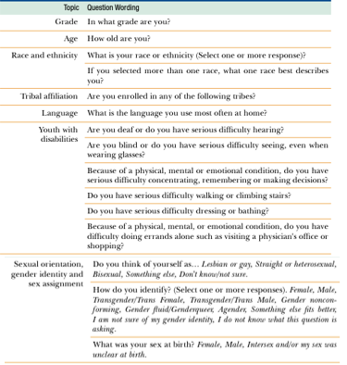
● WHAT ARE SOME OF THE LIMITATIONS OF THIS DATA? (IS IT ONLY AVAILABLE FOR CERTAIN PEOPLE, AT CERTAIN FREQUENCIES?)
Limitations of the Data: The data is collected biennially, which may not provide the timeliest information for evaluating the impact of an intervention. It was Last collected in 2019 and since then has been replaced by Oregon Student Health Survey which is less granular and collected biannually. Though this might just be the initial summary available and might be available in the special request data section of the website. The survey is school-based, hence, it might miss out on adolescents who are not attending school. The self-reported nature of the data might introduce bias.

Slide 22
IN AN IDEAL WORLD, WHAT WOULD YOUR IDEAL DATA INDICATOR BE?
Area of Focus | Description
Real-Time Data Collection | - Continuous monitoring and data collection on adolescent substance use.
 | - Real-time evaluations of interventions.
 | - Prompt identification and response to emerging trends or escalating issues.
Diverse Data Sources | - Data collection from various settings: community centers, healthcare facilities, online platforms, family and social networks.
 | - Collaborations with diverse stakeholders for comprehensive data collection.
Comprehensive Data Points | - Understanding various determinants of substance use: socioeconomic factors, peer influence, mental health status, access to substances, education, and awareness levels.
 | - Evaluation of intervention effectiveness through comparison of substance use rates pre and post-intervention, evaluating the reach and impact of education and prevention programs, and monitoring the utilization and effectiveness of treatment resources.
Enhanced Evaluative Capabilities | - More precise evaluations of interventions enabling adjustments and improvements based on real-time feedback.
 | - Timely evaluations allowing for quicker iterations and improvements to enhance intervention effectiveness.
Holistic Understanding | - Obtaining a well-rounded understanding of adolescent substance use encompassing a wide range of influencing factors.
 | - Providing a more comprehensive picture to facilitate better-informed decisions and tailored interventions to address the root causes of substance use among adolescents.

Slide 23
● EXPLAIN WHY THIS PARTICULAR INDICATOR WOULD BE CRITICAL EVIDENCE TO ADVANCING PUBLIC HEALTH KNOWLEDGE OF THIS AREA.
Aspect | Description
Direct Measurement | Directly measures the core objective: reducing adolescent substance abuse.
Real-world Applicability | Provides practical insights on intervention effectiveness in real-world settings.
Evidence-Based Decision Making | Informs better strategy refinement and resource allocation.
Contribution to Literature | Adds to the body of literature on combating adolescent substance abuse.
Holistic Understanding | Offers insights into the broader impact of reducing substance abuse.
Community and Policy Impact | Influences community support and policy frameworks favorably.
Long-term Public Health Benefits | Sets a precedent for tackling similar public health issues, promoting healthier communities.
The chosen indicator, reduced substance use among adolescents, is instrumental in gauging the success of the intervention and advancing public health knowledge in this domain

Slide 24
CITATIONS
Oregon Healthy Teen Survey 2019: Oregon Health Authority. (2019). 2019 Results: Oregon Healthy Teens Survey. Retrieved from https://www.oregon.gov/oha/PH/BirthDeathCertificates/Surveys/OregonHealthyTeens/Pages/index.aspx.
Oregon Student Health Survey 2022: Oregon Health Authority. (2022). Student Health Survey: Health Surveys. Retrieved from https://www.oregon.gov/oha/PH/BirthDeathCertificates/Surveys/StudentHealthSurvey/Pages/index.aspx.
Teen-Safe Resources: Teen-Safe. (n.d.). Resources. Retrieved from https://teen-safe.org/resources.
Substance Abuse Prevention on Youth.gov: Youth.gov. (n.d.). Substance Abuse Prevention. Retrieved from https://youth.gov/youth-topics/substance-abuse/prevention.
SAMHSA's Substance Use Prevention Resources: Substance Abuse and Mental Health Services Administration. (n.d.). Center for Substance Abuse Prevention. Retrieved from https://www.samhsa.gov/csap.
SAMHSA's Prevention of Substance Use and Mental Disorders: Substance Abuse and Mental Health Services Administration. (n.d.). Prevention of Substance Use and Mental Disorders. Retrieved from https://www.samhsa.gov/prevention.

